Slide 1
Project 1: Best state to register a startup
Kevin Olsen
Patrick Thomas
Arandi Maurine
Kyle Jensen

Slide 2
Project expectations
The analysis uses five data types with the intention of determining the best state in the United States to start a new business.
Notes:
While looking at the data sets we were trying to predict what state would be ranked best or worst

Slide 3
Questions & Data
Questions
The ultimate question asked was: ‘Where should I register my new startup?’
From this main question arose another question which determined the data collected for this project: ‘What factors will a startup be concerned with when trying to register their business?’
Data
Data on competition, corporate taxes, average income in each state, population, and number of new startups in each state was collected to answer the main question.
Was the question answered?
According to the questions asked, 5 unique data sets were used to help answer the questions. These five sources gave all the data needed to answer the ultimate question, where to register a startup.
Notes:
We believed these questions would answer our ultimate question

Slide 4
Reasons for data sets
Existing companies - this was chosen to gauge how competitive a state is compared to other states.
Corporate taxes - this was chosen to help assess how much extra cash a company would have to budget for taxes.
Average income in each state - this would help indicate the spending power of the customers in that state.
Population - this would help indicate how many potential customers there could be.
Number of new startups in each state - This was chosen to help show trends of startups.

Slide 5
Data Exploration and Analysis
Data exploration
Once the datasets were sourced, the team first started by pulling it all into a Jupyter Notebook in the form of data frames.
All extraneous data was dropped from the data frames and any formatting issues were also corrected.
Some of the data frames e.g. number of new businesses were broken down into individual states and this were combined into a single dataframe using pd.concat
Standard deviation was performed on two of the datasets - Number of new businesses and Average income. This was the most efficient way to determine the trend over the past 5 years.
Data Analysis
Data analysis involved ranking the 5 factors
Corporate Tax Rate - the lower the rate, the higher the ranking
Population - the higher the population the more potential customers there are thus a higher ranking
Number of total businesses per state - indicates the state’s competitiveness and the higher this is, the higher the ranking
Number of new businesses - This also indicates competitiveness and trends and was ranked higher if there are more startups
Average income per state - Higher income denotes spending power and was ranked thus.
A new dataframe was created by defining the cumulative ranking of all the factors. This is what was ultimately used to rank the states from best to worst for startups.
Notes:
Why was standard deviation done - To also get the data into a comparable state
Examples of format issues - undesired commas, change strings to integers or floats
Extraneous data included data on US territories which was outside the scope of this project.
The biggest challenge here was some of the datasets were only available state

Slide 6
Data Exploration and Analysis
Challenges -
Finding relevant data for our variables,e.g. average income over 5 years or dated data e.g. population data is based on the census data from 2019
The data was had to be downloaded in bits and pieces, that complicated the reading of the data into our .ipynb file
Some datasets had extraneous data that proved to be a challenge in the coding portion of the project
Successes
The team was able to work cohesively together and take in ideas from each other
We were able to overcome our challenges and able to answer our main question

Slide 7
Findings
Top 5
Texas
Florida
Michigan
Ohio
California
Bottom 5
Kansas
Montana
Idaho
Vermont
Delaware
Notes:
Our findings from our analysis points to Texas as the best state to open a new business in, according to our ranking system (about 7.5% better than next best ranked state Florida). On the opposite end of the rankings was Kansas, which was the worst state to open a business in (about 13% worse than next worst ranked state Montana).

Slide 8
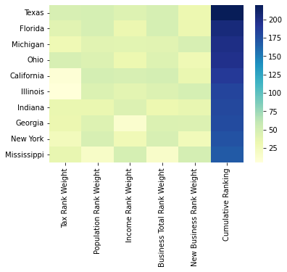
Notes:
The heatmap helps show where some of the ranking disparities lie between the top ten ranked states. It shows how states like California and Illinois had good ranks in 4 categories, but were both in the bottom ten ranks for corporate taxes, causing their overall rankings to lie at 5 and 6 respectively. It also shows how Texas only has a small deficiency in their overall score due to 32 ranking points attributed to their new business weight rank. To add some perspective, the 10th ranked state of Mississippi is 76.5% of the overall grade of top state Texas, and 88.9% of the overall rank of the 5th ranked state California.

Slide 9
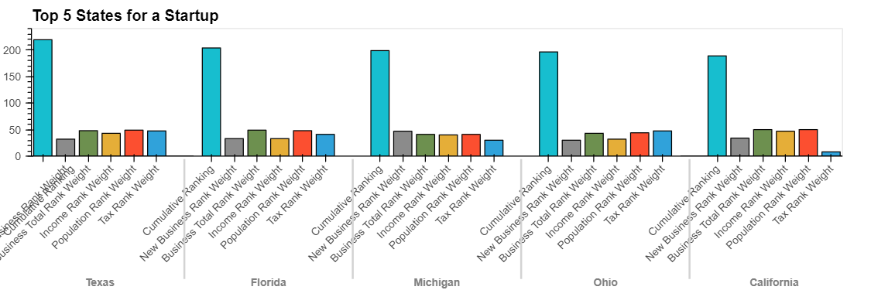
Notes:
The bar graph also shows where these ranking differences lie between states, further reinforcing how big of a difference having one low ranking can affect the overall score greatly (California). The top ranked states all consistently have weighted rank scores in the 30s and 40s, with California’s corporate tax rate being the lone outlier.

Slide 10
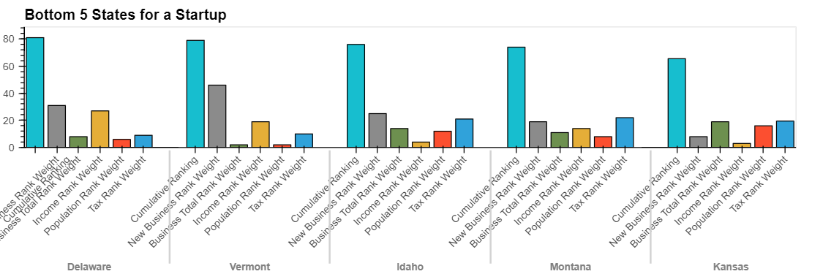
Notes:
This graph shows the bottom five ranking and helps explain why they are at the bottom. A good example of this can be found in the states of Vermont and Delaware. With these states, their middling rankings in two categories were negatively impacted in large ways by the other three rankings being so low. With Vermont’s ranking being so low to place the overall ranking in the bottom 5 while having a top 10 ranking in new business weight rankings. Kansas is both the worst overall ranking and has no rank weight over 20, with two ranks in the bottom ten. This easily solidifies it with the worst overall ranking.

Slide 11
Outcome
What kind of startup is this? Will they be providing a service or a good? What other companies have moved to these states?
What are negative topics to weigh over states, such as government policy or crime rate. Alongside environmental factors.
Research based on business demographics and what percentage of startups last longer than a year.

Slide 12
Links
Deployed application.
GitHub repo.

